Slide 1

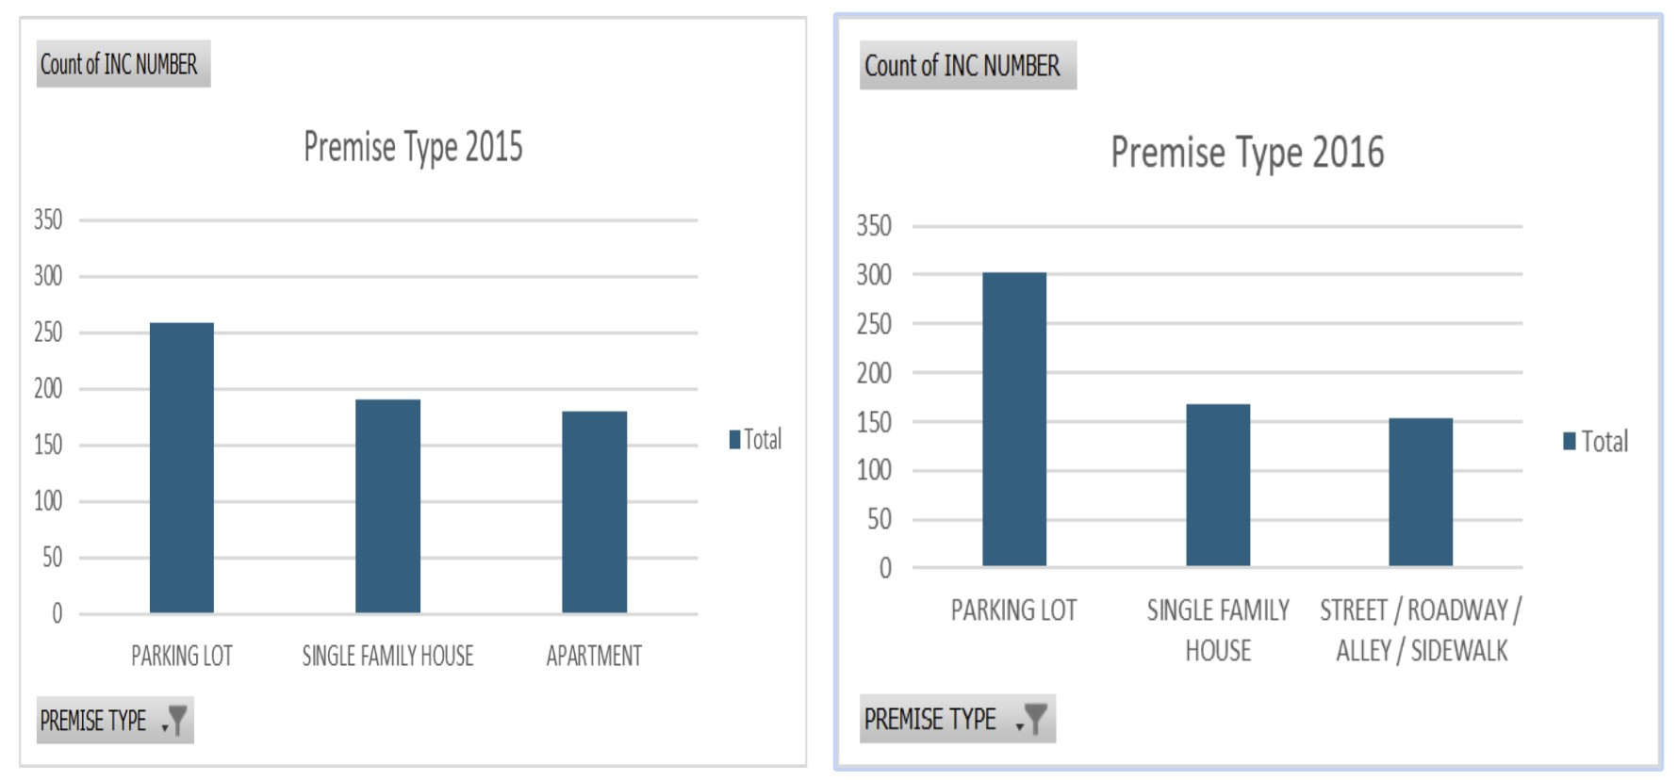
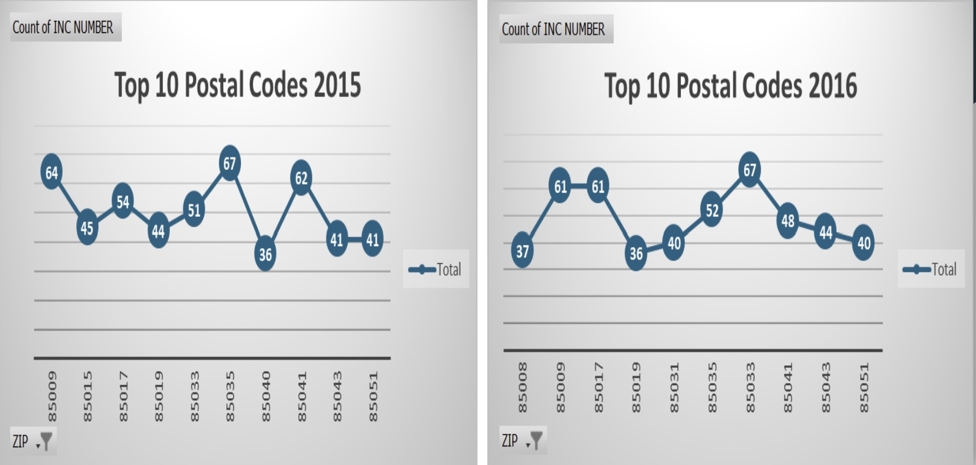
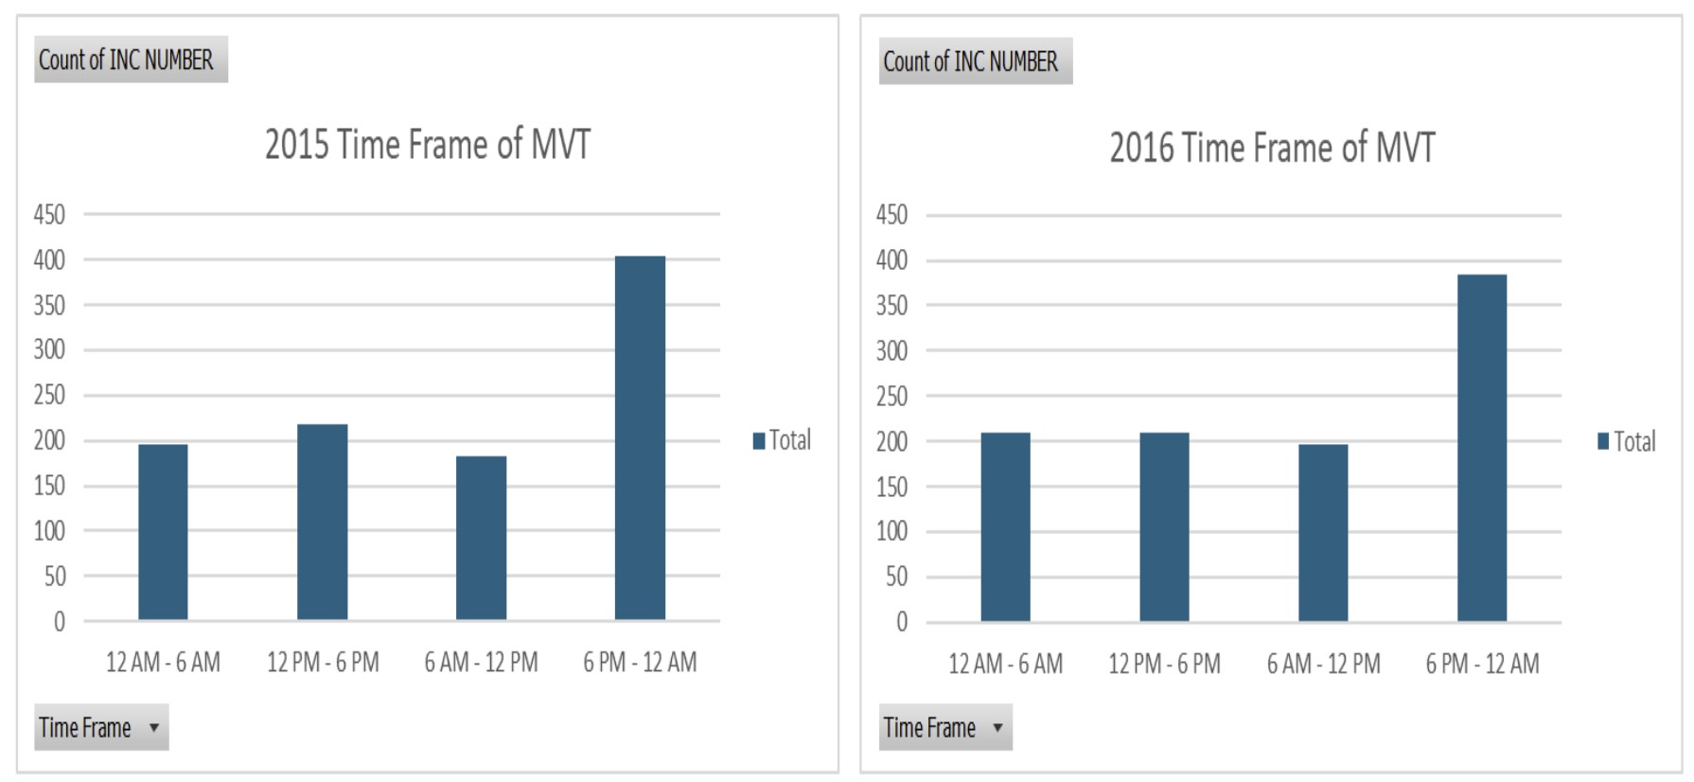
Crime Busting Motor Vehicle
Thefts In Phoenix
ABSTRACT
Problem Statement
PSEUDO CODE
This analysis examines the time of day, premise types, and geographic distribution of motor vehicle thefts. The goal is to identify patterns in theft occurrences and the top 10 zip codes most affected.
Time of Day:
We will examine the times at which these crimes are most likely to occur.
Premise Type:
We will categorize the locations where these thefts are happening to understand if certain types of premises are more susceptible.
Geographic Distribution:
We will identify the top 10 zip codes where Motor Vehicle Thefts are most frequently reported.
1
Calculate total thefts for each target month of each year. (eg. Nov. & Dec. of 2015 and 2016)
Compare the totals. (eg. Increase, Decrease, No Change)
Output results. (eg. “There is {trend} in motor vehicle thefts between November and December.”)
2
Compare the total thefts between 2015 and 2016. (eg. Increase, Decrease, No Change)
Output the result. (eg. “There is a {trend} in motor vehicle thefts between 2015 and 2016.”)
3
Categorize the ‘Time_Frame’ column into time ranges. (eg. 12 AM - 6 AM; 6 AM - 12 PM; 12 PM - 6 PM; 6 PM - 12 AM).
Count the number of thefts for each time frame.
Identify the time frame with the highest number of thefts.
Output results. (eg. “The majority of motor vehicle thefts occur during the {peak_time_frame} time frame.”)
4
Extract the 'Time_Occurred' column.
Group the data by 'Time_Occurred'.
Count the number of thefts in each time range.
Identify time ranges with the highest theft frequency.
Output the time ranges with higher theft frequencies.
5
Extract the 'ZIP' column.
Group the data by 'ZIP'.
Count the number of thefts in each ZIP code.
Sort the results in descending order of theft count.
Output the ZIP codes with the highest theft counts.
6
Extract the 'PREMISE_TYPE' column.
Group the data by 'PREMISE_TYPE'.
Count the number of thefts for each premise type.
Sort the results in descending order of theft count.
Output the premise types most frequently targeted.
Questions
Comparison Graphs
How do the total number of motor vehicle thefts in November and December of 2015 compare to the same months in 2016?
Is there a noticeable increase or decrease in thefts between 2015 and 2016?
What time of day do most motor vehicle thefts occur?
Are there specific hours during the day that show a higher frequency of thefts?
Which zip codes have the highest number of motor vehicle thefts?
What type of premises (residential, commercial, public) are most frequently targeted for vehicle thefts.
Graph 1. Comparison of top 3 Premise type
Graph 3. Comparison of top 10 postal codes
Graph 2. Comparison of time frame of MVT
CONCLUSIONS
CONTACT
The analysis of motor vehicle thefts highlights key trends in when and where these crimes occur, along with the areas most affected. This information empowers law enforcement to allocate resources efficiently, helps vehicle owners to take preventive measures in high-risk zones, ultimately contributing to a reduction in theft incidents and better community safety.
Law Enforcement Agencies: Helps identify crime hotspots and peak times, allowing for better resource allocation and targeted prevention efforts.
Vehicle Owners: Raises awareness about the areas and times most susceptible to theft, enabling them to take preventative measures.
Barbie Conedy (bconedy@asu.edu)
John Huang (chuan221@asu.edu)
Milan Paremajalu (mparemaj@asu.edu)
Rae Wright (rlwrigh5@asu.edu)
Venkat Balaji (vbalaj13@asu.edu)

